Slide 1
Hydropower Vision
Team May 15-08
Advisor:
James McCalley
Members:
Alex Tillema - Team Leader
Nicholas Jones - Communication Leader
Kyle Kraus - Key Concept
Jared Ward - Key Concept
Josh Martinson - Team Webmaster
Mohammed Aldhaheri - Research Lead
Notes:
Presenter: Alex

Slide 2
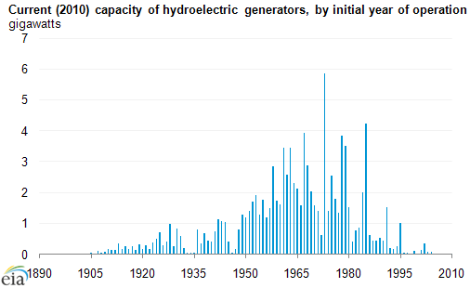
Project Scope/Background
DOE Wind and Water Power Technologies Offices seeking to establish analytical basis for growth in hydropower over the next half century
Notes:
Presenter: Alex
Why the need for this project?
Not much hydropower added since 1970
Room for new technology
Need for electrical storage (Pumped Hydro)
Works well with other renewables
Incorporate how this is an electrical engineering project
Emphasis on us being in power systems field

Slide 3
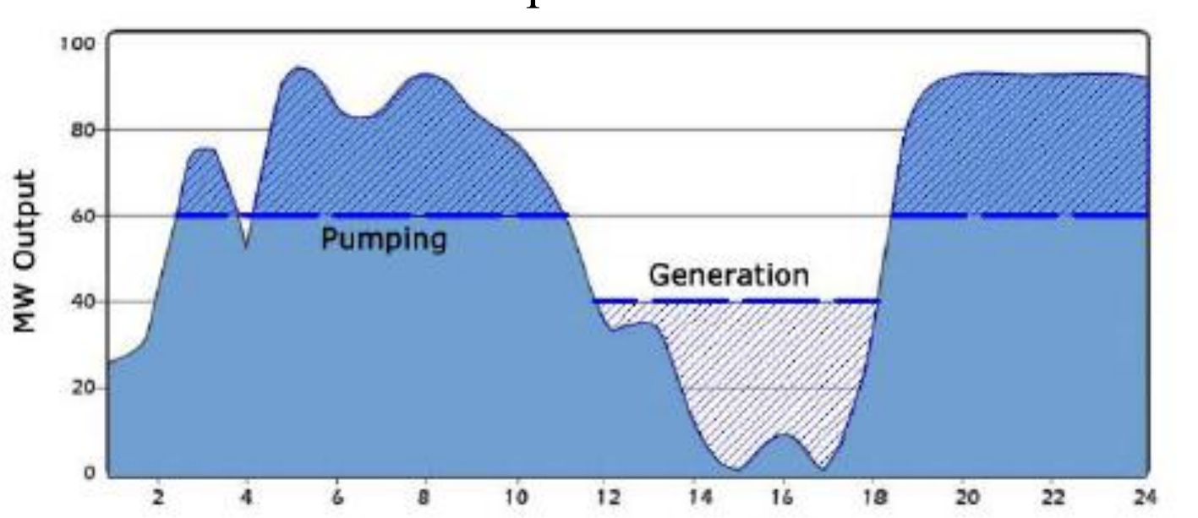
Hydropower & Wind Benefits
Wind Generation is a intermittent source
Pumped Hydro used as a compensator
Adding Hydro to a grid with a large wind generation capacity makes the grid more reliable, thus our goal
Notes:
Presenter: Alex
Goal was to try to locate a place with large wind penetration and the ability to have large hydro powe

Slide 4
Region Identification in the US
Highest potential were in Washington, Idaho, Alaska, Oregon, Montana, and California
Washington, Idaho, Oregon, and Montana facing natural wildlife issue and already large installed hydro capacity
Concern over water supply in California
Alaska- small demand for electricity
Decided to look at Colorado, Pennsylvania, and Missouri but there was no incentative to build in these states
Decided to look to our neighboors in the north
Notes:
Presenter: Kyle

Slide 5
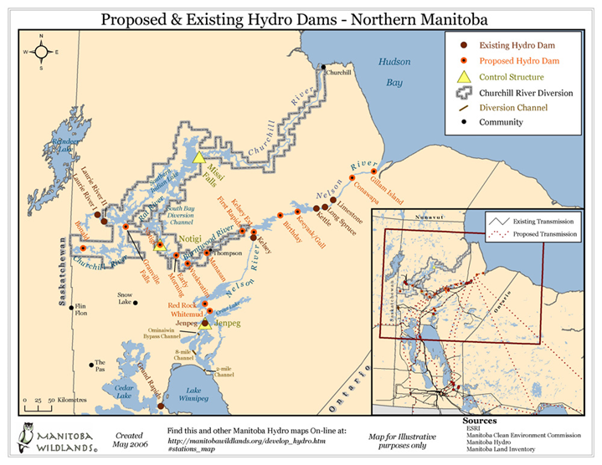
Manitoba Province
Current Installed Hydro - Capacity of 5,217 MW
Has the potential to add 8,785 MW of hydro capacity
Is already planning on 2,230 MW over the next 15 years
Current Export Capacity 1,850 MW
Approved construction of a 500kV transmission line between Dorsey, Manitoba to Duluth MN.
Notes:
Presenter: Kyle

Slide 6
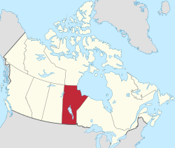
Overall Project Goal
Model Manitoba hydro expansion tied into MISO network.
Notes:
Presenter: Kyle
SO OUR GOAL WAS TO MODEL THE MISO MARKET…NOW WHAT IS MISO
Break up our design into 5 sections later on
98% of Manitoba electricity is hydropower
4,095 Billion kWh (B kWh) of electricity consumed

Slide 7
How does MISO Model LMP?
Notes:
Presenter: Josh

Slide 8
Notes:
Presenter: Josh
LMP is locational marginal price
This is just additional data supplied by the Midwest Independent System Operator to show current prices
Helped with our understanding of the values we are getting

Slide 9
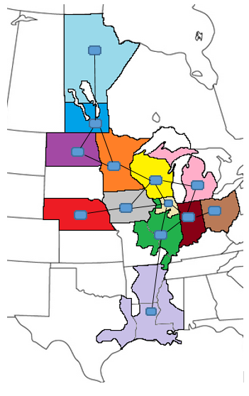
Power Flow Model
13 node model of MISO and surrounding regions using PLEXOS
Used EIA data to compile generation and load data for each region
Ran simulations for every day for 30 years
Ran week long 5 min simulation in year 2032
Notes:
Presenter: Nick

Slide 10
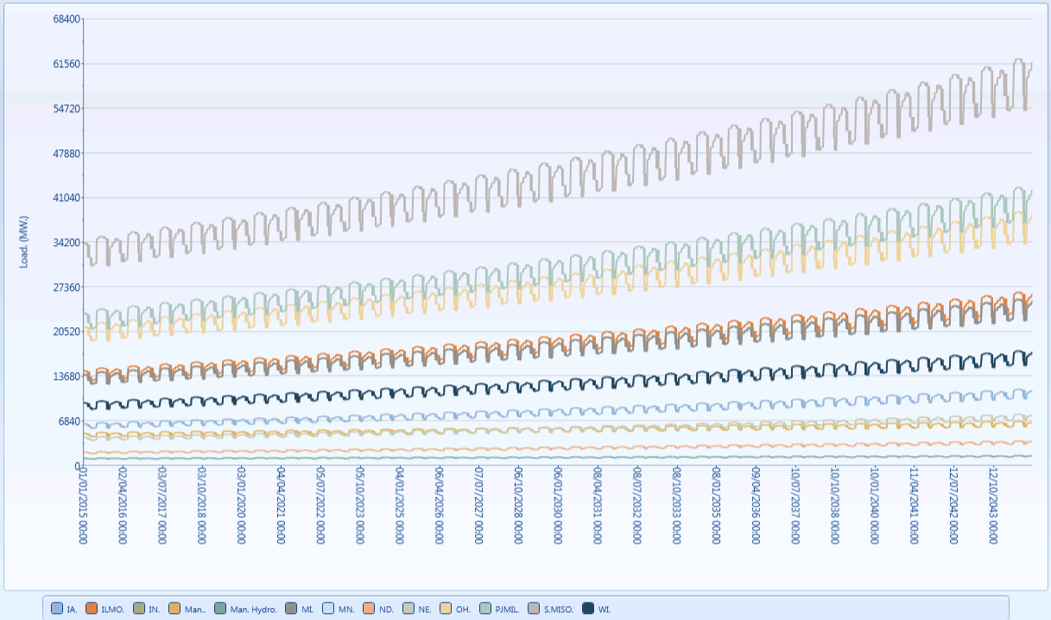
Power Flow Model-Load
Varied yearly load to adjust for seasonal changes
Increased load conservatively 2% per year
Data had to be entered into an excel spreadsheet
For each node this was 10,950 different values
Notes:
Presenter: Nick
Using EIA and MISO assumptions

Slide 11
Power Flow Model-Generation
Base Model
Wind increase and coal decrease based off MISO predictions
No hydro expansion and same Manitoba export capacity
Hydro Model
Doubled wind increase from base model
Doubled coal decrease from base model
Added 1000 MW to Manitoba export capacity from Manitoba to Minnesota line
Generation: | 2016 | 2017 | 2018 | 2019 | 2020 | 2021-2045
Coal | -4.8% | -9.2% | -.8% | -.8% | -.8% | -.8%
Natural Gas | +2% | +2% | +2% | +2% | +2% | +2%
Wind | +.5% | +.5% | +.5% | +.5% | +.5% | +.5%
Nuclear | +.6% | +1.9% | -.9% | -1.1% | -1.7% | +.2%
Notes:
Presenter: Nick
Great for two reasons it adds to the green economy by doubling wind construction from predicted growth and it also uses hydro as a compensator instead of coal or natural gas

Slide 12
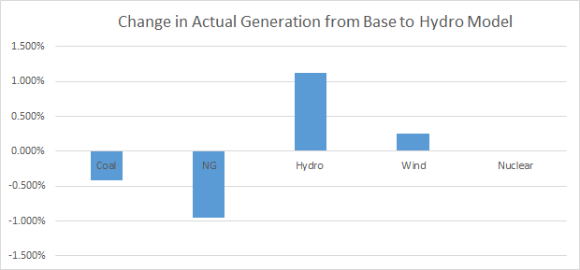
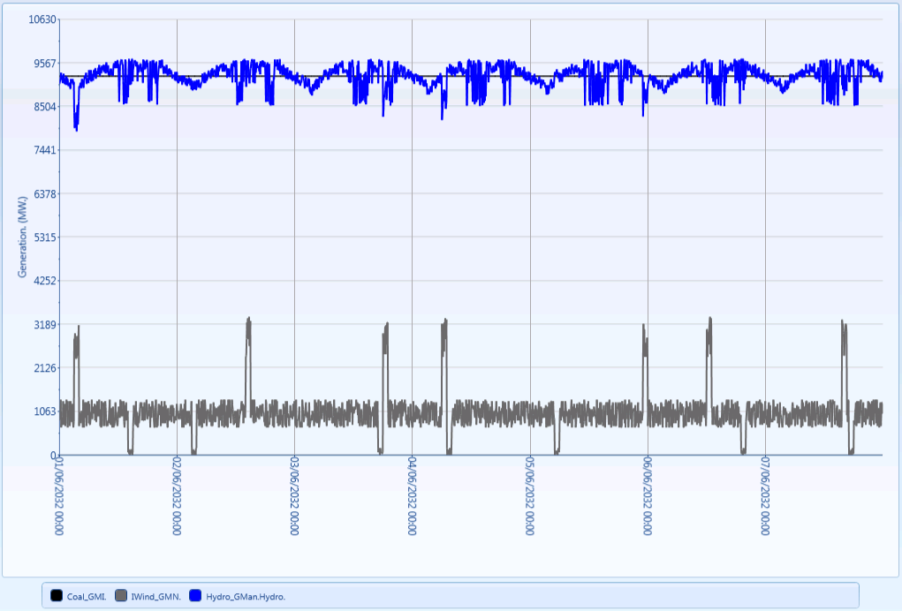
Power Flow Model – Year 2032
1 week model taking place in the year 2032
Calculations done every five minutes.
Coal generation’s max capacity was the same in both short term models
Shows how hydro compensates for the variability of wind generation
The graph below shows the over all difference in generation from our base model compared to our hydro model
Notes:
Presenter: Jared
Diurnal benefits of having hydro generation allowed greater wind penetration
LT: 10958
ST: 2016

Slide 13
PLEXOS Demonstration Video
Notes:
Presenter: Jared

Slide 14
Challenges and Solutions 1
Problems with licensing Issues
- Does not account for start-up cost, forcing large spot prices
Solution: Rapid communication with advisor to obtain license
Production Cost Model within PLEXOS
Solution: Set various minimum generation limits
Notes:
Presenter: Nick

Slide 15
Challenges and Solutions 2
How to model wind generation
Solution: Add in random generation capacity
Predicting load growth over 30 years
Solution: Used conservative 2% base increase with variance per month
Difference between MISO and our model (13 vs 50000 node)
Solution: Used EIA data to create the most accurate data. ST-Model results were similar to current MISO LMP
Notes:
Presenter: Jared

Slide 16
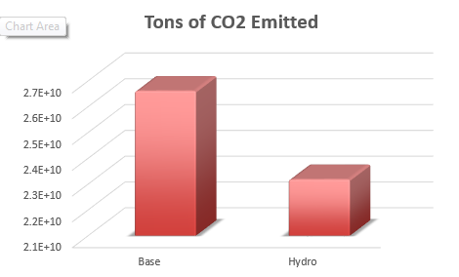
Results
System cost reduced by 1.8%
12.9% decrease in CO2
We recommend to build and utilize Manitoba’s hydro potential to fully utilize the benefit of wind power.
Notes:
Presenter: Mohammed

Slide 17
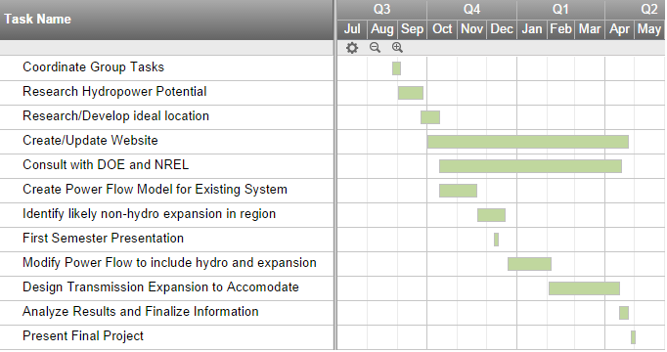
Project Schedule and Costs
Costs
$15 – Poster Lamination
Total Cost: $15

